Slide 1

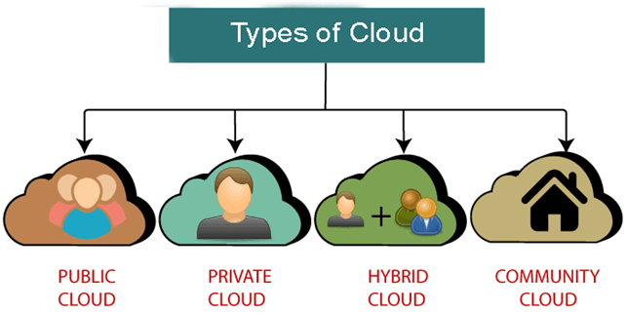
Types of Cloud Types of Cloud

Slide 2
Public Cloud
provides a shared platform that is accessible to the general public through an Internet
operated on the pay-as-per-use model and administrated by the Cloud service provider
same storage is being used by multiple users at the same time
owned, managed, and operated by businesses, universities, government organizations, or a combination of them

Slide 3
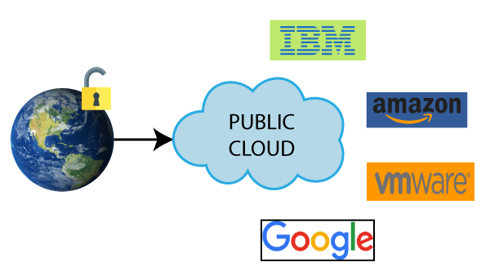

Public Cloud Service Provider
etc

Slide 4
Advantages of Public Cloud
Business Agility | provides an ability to elastically re-size computer resources based on the organization's requirements.
Location Independent | location independent because its services are offered through the internet.
Save Time | cloud service provider is responsible for the manage and maintain data centers so the user can save their time to establish connectivity, deploying new products, assemble servers etc.
Quickly and easily set up | Organizations can easily buy public cloud on the internet and deployed and configured it remotely.
Scalability and reliability | offers scalable and reliable (24*7 available) services to the users.
Low Cost | lower cost than private, or hybrid cloud, as it shares the same resources with a large number of consumers.

Slide 5
Disadvantages of Public Cloud
Low Security | less secure because resources are shared publicly.
Performance | performance depends upon the speed of internet connectivity.
Less customizable | less customizable than the private cloud.

Slide 6
Private Cloud
known as an internal cloud or corporate cloud.
provides computing services within the organization instead of the general public.
provides a high level of security and privacy to data through firewalls and internal hosting. It also ensures that operational and sensitive data are not accessible to third-party providers.
owned, managed, and operated by businesses, universities, government organizations, or a combination of them
HP Data Centers, Microsoft, Elastra-private cloud, and Ubuntu are some examples

Slide 7
Advantages of Private Cloud
More Control | more control over their resources and hardware than public clouds because it is only accessed within organization.
Security & privacy | one of the big advantages over public cloud.
Improved performance | better performance with improved speed and space capacity.

Slide 8
Disadvantages of Private Cloud
High cost | The cost is higher than a public cloud because set up and maintain hardware resources are costly.
Restricted area of operations | accessible within the organization, so the area of operations is limited.
Limited scalability | are scaled only within the capacity of internal hosted resources.

Slide 9
Hybrid Cloud
combination of public and private clouds.
main aim to combine Public and Private cloud is to create a unified, automated, and well-managed computing environment.
non-critical activities are performed by the public cloud and critical activities are performed by the private cloud.
Mainly, a hybrid cloud is used in finance, healthcare, and Universities.
hybrid cloud provider companies are Amazon, Microsoft, Google, Cisco, and NetApp.

Slide 10
Advantages of Hybrid Cloud
Flexible and secure | provides flexible resources because of the public cloud and secure resources because of the private cloud.
Cost effective | offers the features of both the public as well as the private cloud. It helps organizations to save costs for both infrastructure and application support.

Slide 11
Disadvantages of Hybrid Cloud
Networking issues | networking becomes complex because of the private and the public cloud.
Infrastructure Compatibility | with dual-levels of infrastructure, a private cloud controls the company, and a public cloud does not, so there is a possibility that they are running in separate stacks.
Reliability | The reliability of the services depends on cloud service providers.

Slide 12
Community Cloud
allows systems and services to be accessible by a group of several organizations to share the information.
owned, managed, and operated by one or more organizations in the community, a third party, or a combination of them.
Example: Our government organization within India may share computing infrastructure in the cloud to manage data.

Slide 13
Advantages of Community Cloud
Cost effective | the whole cloud is shared between several organizations or a community.
Flexible and Scalable | allows the users to modify the documents as per their needs and requirement.
Security | more secure than the public cloud but less secure than the private cloud.
Sharing infrastructure | allows us to share cloud resources, infrastructure, and other capabilities among various organizations.

Slide 14
Disadvantages of Community Cloud
not a good choice for every organization.
Slow adoption to data.
The fixed amount of data storage and bandwidth is shared among all community members.
costly than the public cloud.
Sharing responsibilities among organizations is difficult.

Slide 15
Types of Cloud
Thank You

